Slide 1
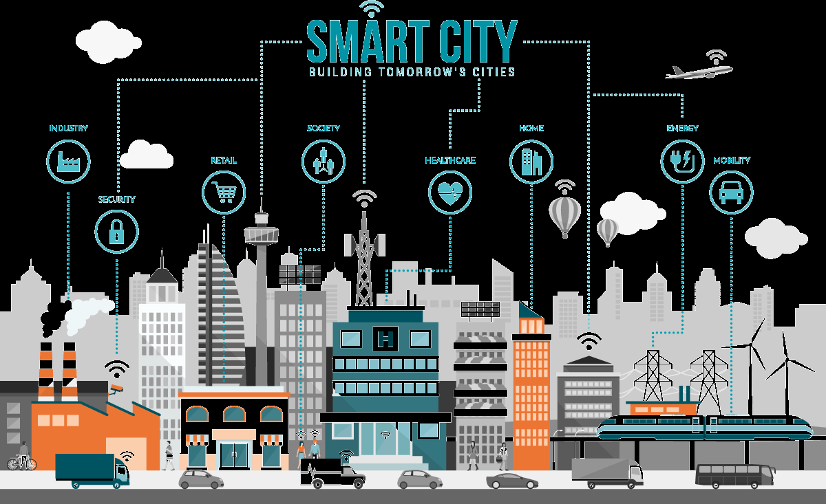
City as a Service
Mayur Hooli

Slide 2
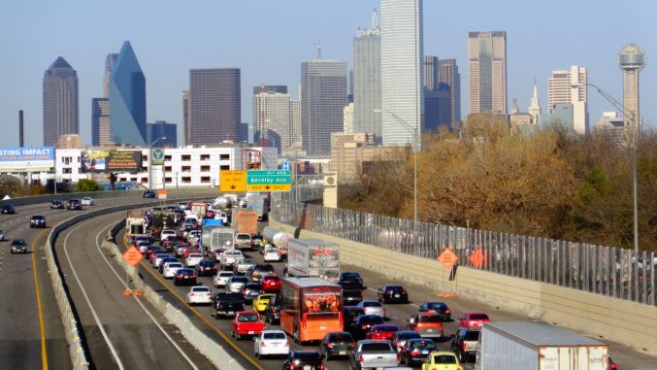
Problems of the 21st Century Cities
Over half the World’s Population today lives in cities
3 Million people migrate to cities every week
Resources in the cities are finite
The solutions that we use today are the same that we used in the 20th Century
These solutions don’t work in today’s context as they are outdated
Bangalore was designed for 5 Million People, but now there are 20 Million People

Slide 3
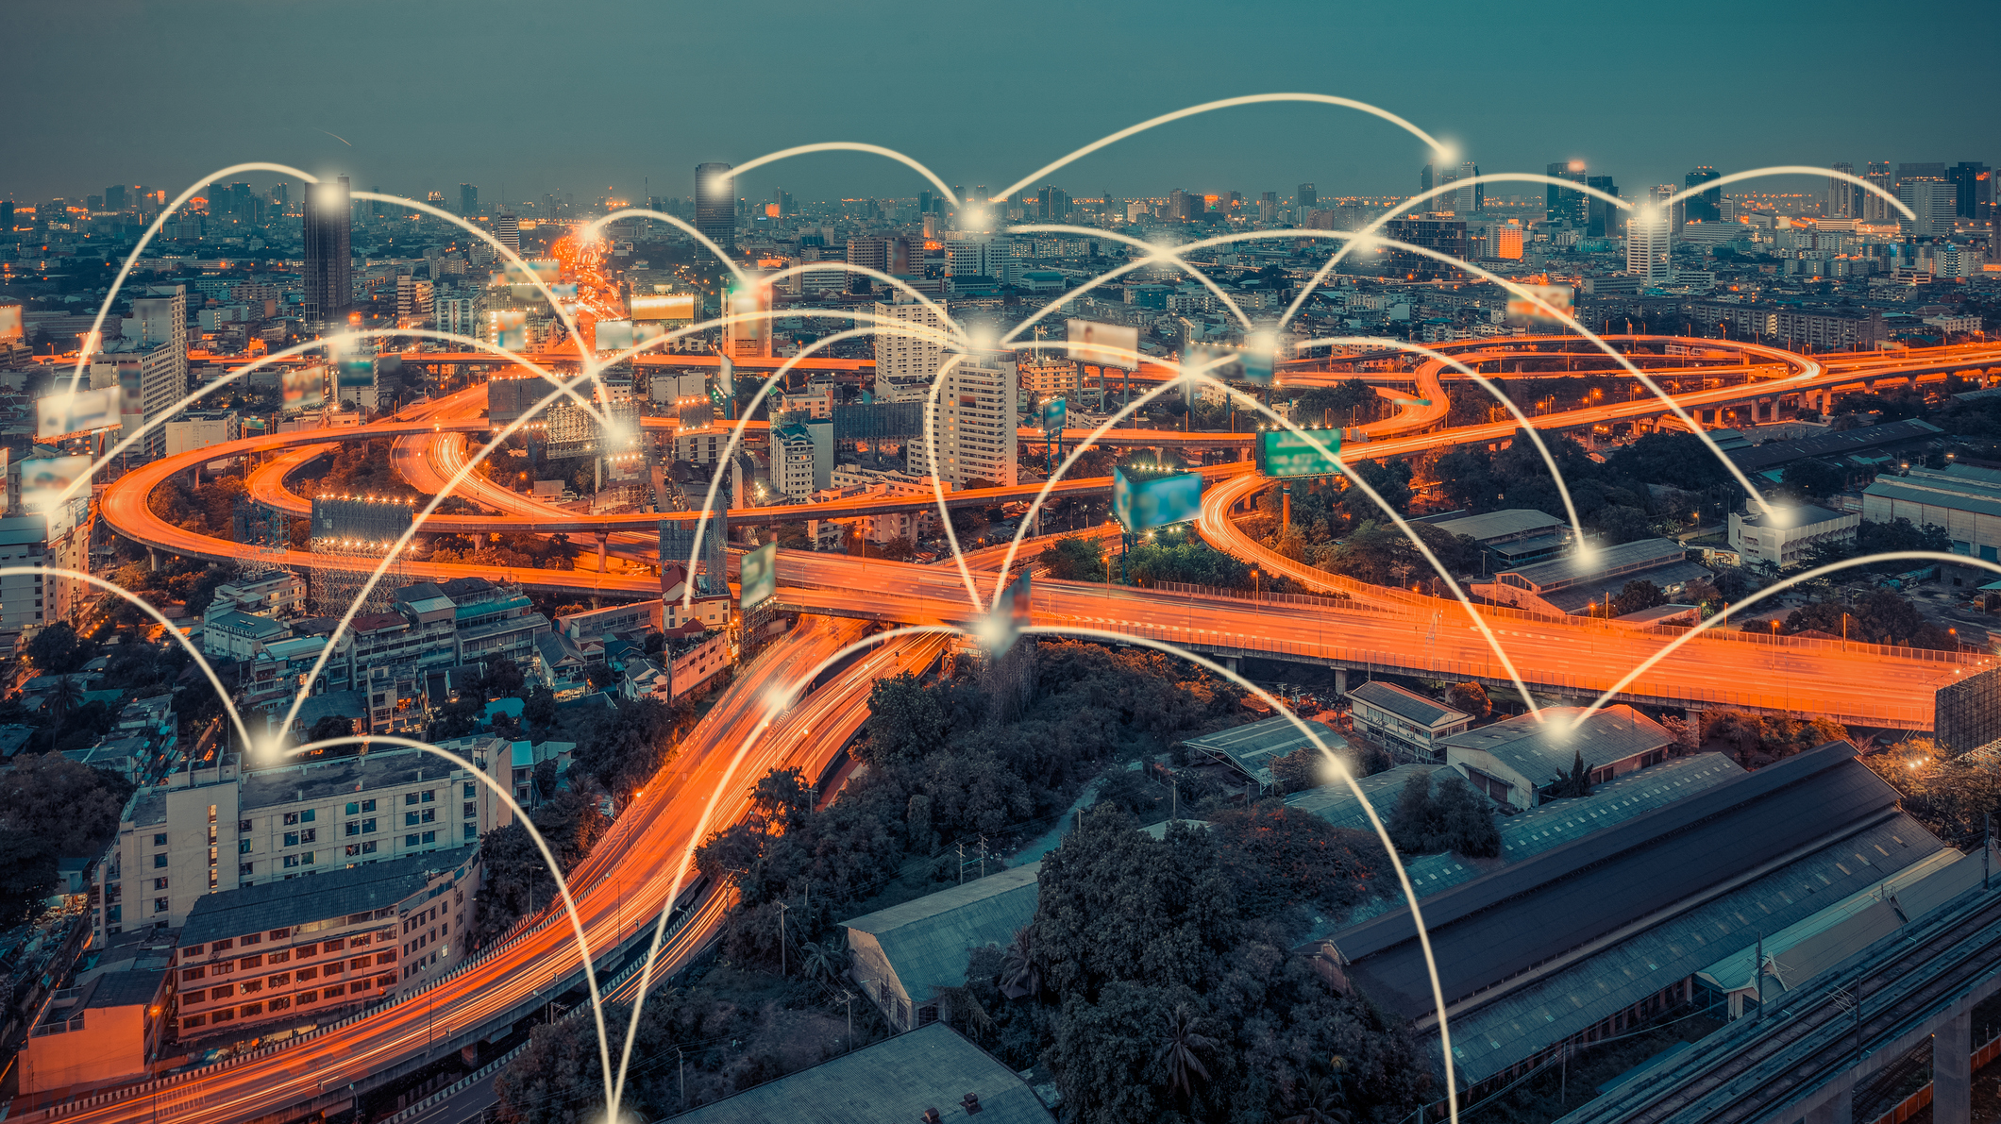
Cities of the Future
New Solutions are needed for the problems of the new age
A sensor network enables us to monitor the city and identify the solution
Data available to the residents can help people plan
The target would be the entire city

Slide 4
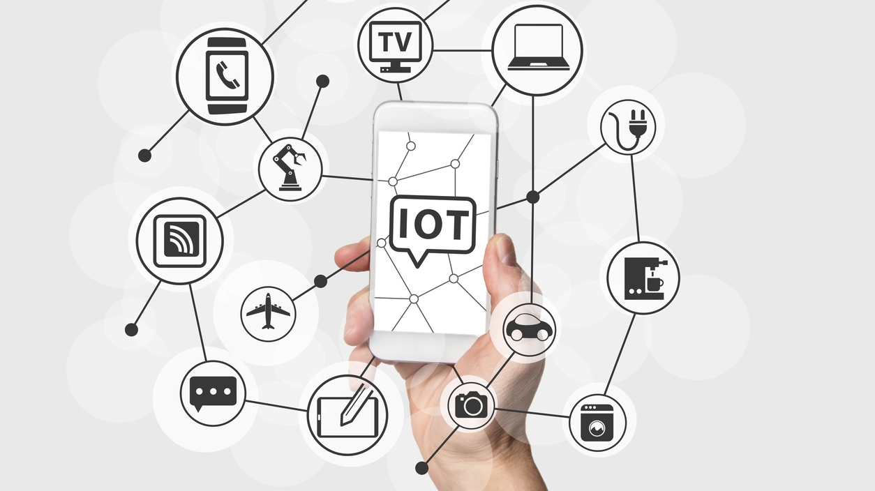
Internet of Things
Internet of Things is a network of Physical Devices to Sensors and Actuators which enables them to exchange data
The concept isn’t new and has been in development since 1999
Today, we see Internet of Things devices in various aspects of our life such as Smart Homes, Healthcare, Agriculture, Self-Driving Cars, etc.
There are over 10 Billion Internet connected devices as of 2018, which will grow to nearly 20 Billion in 2020
This is an industry with huge potential and a projected valuation of $7.1 Trillion by 2020

Slide 5

Machine Learning
Machine Learning has existed for almost 60 years
Early Machine Learning Models were Rule Based
The Machine Learning Models used today use a large number of examples and create their own rules
There are 5 tribes of Machine Learning:
Symbolists: Rule Based
Connectionists: Mathematics (Taking off using Neural Nets and Deep NN)
Analogizers: Analogy
Evolutionists: Use Game Theory
Bayesians: Use Statistics
Neural Networks, loosely based on Neurons in the human brain are picking up pace

Slide 6

Machine Learning Progress
Machine Learning isn’t something new but has really grown since 2006
Main factors for the sudden growth of ML:
Moore’s Law
Big Data
Tinkering with Old Techniques
New Computer Architecture
The reason for this sudden growth can be given using the Chess & Grain Analogy
Doubling can catch you by surprise
Doubling gets crazy during the second half where Intuition fails to keep up

Slide 7
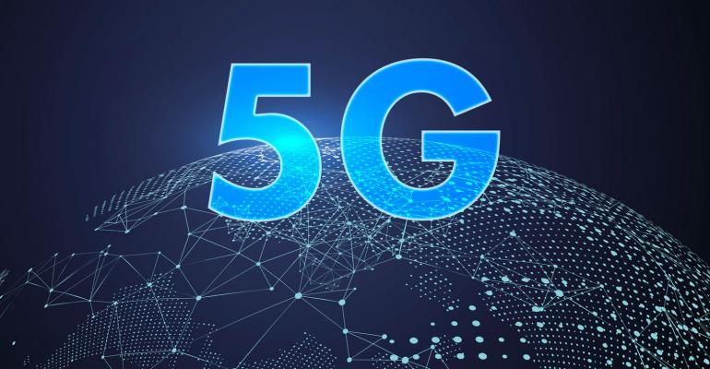
5G
In addition to higher data rates over the existing 4G network, 5G is a heterogeneous network with concurrent operations of multiple cells
5G has a lower latency than 4G which is very useful in time critical applications
5G offers the ability to spin-up virtual networks on demand
In addition to this, 5G consumes low power which will enable longer lifetime of devices

Slide 8
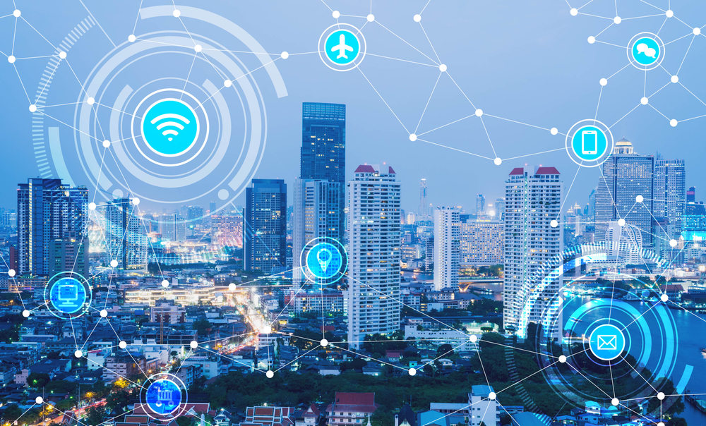
Smart City Platform
Growing interest in smart city platforms is a logical outcome of the continued evolution of smart city programs
The concept of the smart city platform combines an ambitious vision for the integration of urban services and the more pragmatic development of foundational layers that will enable that vision
Smart city platforms are part of a wider transformation in urban infrastructure and services that is being driven by the deployment of Internet of Things (IoT) solutions and other smart city technologies
Citywide sensor networks, ambitious data platforms, and integrated approaches to issues like urban mobility, energy management, and public safety are laying the foundation for city platform strategies.

Slide 9
Smart City Platform
A city platform provides the integrated capability to coordinate data, applications, and services at one or more levels across operational domains for multiple stakeholders
Diverse sets of platform technologies enable the smart city
The capabilities these technologies offer can be combined in multiple ways to create a smart city platform suited to specific needs
Cities need to develop capabilities that enable them to manage resources and deliver services in the world shaped by platforms such as Uber, Airbnb, Amazon, Google, or Facebook
The city as a service concept is the natural development of this move to a platform approach
Developing the right platforms will be key to cities building the partnerships they need to ensure that their economies, environment, and services are fit for the future

Slide 10
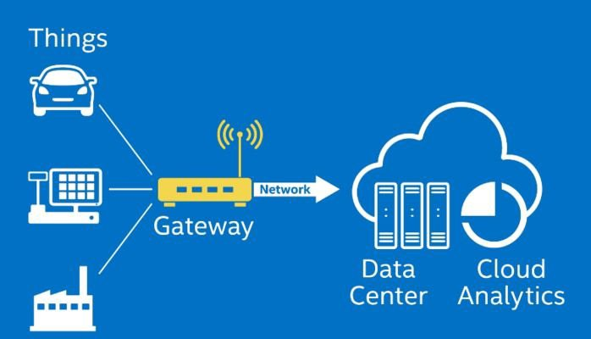
Antenna as a Gateway
This needs further understanding
For the Platform to work in a way no one else has done, it is critical to understand how the Antenna could double up as an IoT Gateway
The 4G Antenna in comparison could be considered a Router which can be connected to only one type of network

